Slide 1
国際学会詐欺
佐々木甚一

Slide 2
◇事件の発端
2013年9月24日 午後、ロンドンで開催される地球環境をベースに多くの研究領域をカ
バーする国際学会案内が届いた。
2012年9月、「第一回アジア食料学会」が大阪で立ち上がり、そこで「Earthquake-
Caused Tsunami, Infection And Nuclear Plant Accident in Japan」 の演題で特別講
演をしたが、その情報が流れて学会通知が来たものと思われた。案内書の中に次のよう
な一部があった (詳細は次ページで紹介）。
“Registration is free of charge for delegates from developing countries. Also free
flight tickets, travel insurance, visa fees and per diem will be provided for all
Paper presenters and participating delegates.”
日本は Developing countryではないが面白い学会だと思い、アブストラクトを送り返
事を待った。

Slide 3
◇2013年9月24日に届いたロンドン国際学会の案内文面
（あまりにも多くの研究領域が記載されているので学会としては特異的だな・・・と思う）
❶ 2013年9月24日 1:29
Dear Colleague,
We are writing this letter to you, in order to invite you wholeheartedly to our 2013 Global Conference on Environmental Dynamics, Science and Technology in London (GCEDST 2013) is the premier forum for the presentation of new advances and research results in the fields of Technology. The conference will bring together leading researchers, engineers and scientists in the domain of interest from around the world. Topics of interest for submission include, but are not limited to: *Environmental Science and Technology* Environmental dynamics* Meteorology* Hydrology* Geophysics* Atmospheric physics* Physical Climate and climatic changes* Global warming* Ozone layer depletion* *Carbon capture and storage* Biofuels* Integrated ecosystems management* Habitat reconstruction Biodiversity conservation* Deforestation* Wetlands* Landscape degradation and restoration* Ground water remediation* Soil decontamination* Eco-technology* Bio-engineering* Environmental sustainability* Resource management* Life cycle analysis* Environmental systems approach* Renewable sources of energy-energy savings* Clean technologies* Health and the Environment* Health related organisms* Hazardous substances assessment and epidemiological studies* Quality guidelines, environmental regulation and monitoring* Indoor air pollution* Water resources and river basin management* Regulatory practice, water quality objectives standard setting, water* quality classification* ・・・・・・・・・.Proposal Submission: Interested presenters should submit an abstract of less than 500 words and a short bio of 100 words on or before extension 7th October,2013. Registration: Each delegation is entitled to come with 1 or 3 delegates either from the same institution/organization or as the case maybe. Registration should be done immediately the abstract is accepted. Registration is free of charge for delegates from developing countries. Also free flight tickets, travel insurance, visa fees and per diem will be provided for all paper presenters and participating delegates. Email: <conference@gcedst.org.uk> for more details on online registration, abstract submission, full papers, power point presentation, accommodation, flight and venue. Important Dates: Extension Date For Abstract Submission: 7th October,2013 Final Paper Submissions: 29th October, 2013 GCEDST 2013 Conference Dates: 25-29 November, 2013
We look forward to welcome you at the conference. Regards,
Dr. Calvin Albert Secretary, Ph:+447053828354 Address:241b, Hoe Street, Walthamstow, London, E17 9PP, United Kingdom.

Slide 4
◇応募の結果「口頭発表部門に採用する」との通知が届く
（学会スポンサーがお金を出すので「Bolton Palace Hotel」を予約し領収書を送るようにと指示）
❷ 2013年9月30日 17:54
Dear Jin-Ichi Sasaki, Hirosaki University of Health Science, Japan. We have looked at your abstract titled:"Quake-Caused Catastrophe and Post Fact Report from Japan-Tsunami, Infection, and Radioactivity”
Your abstract is acceptable for oral presentation; send in the full paper for review and inclusion in our final program of event which will enable your presentation at the Global Conference on Environmental Dynamics, Science and Technology session slated for 25th – 29th November, 2013 at the Bolton Palace Hotel. Also log on www.gcedst2013.org.uk to complete the registration and access grant application forms respectively to enable the Global Conference on Environmental Dynamics, Science and Technology Committee fund your air ticket, visa fee, travel insurance and per diem.
To enable our sponsors approve and disburse your access grant at the earliest, all delegates were instructed to include the cost of their hotel reservations in per diem for reimbursement during the disbursement of the access grant. Send in your hotel reservation receipt issued by Bolton Palace Hotel, the venue of the Global Conference on Environmental Dynamics, Science and Technology to enable the GCEDST 2013 Organizing Committee issue your invitation letter and disburse your access grant within two working days on receipt of your reservation receipt. Email: Bolton Palace Hotel <reservations@boltonpalacehotel.co.uk> to book your hotel reservation immediately.
We look forward to meeting your delegation in London!
Congratulations!!
Regards,
Dr. Mike Lawrence, Conference Chairman 241b, Hoe Street, Walthamstow, London, E17 9PP, United Kingdom. Ph: +44 7053828354 Fax: +44 8435241465 Email: conference@gcedst2013.org.uk
Important Dates Deadline For Abstract Submission: 26th September, 2013 Final Paper Submissions: 29th October, 2013 GCEDST 2013 Conference Dates: 25-29 November, 2013
GCEDST 2013 Experts <conference@gcedst2013.org.uk>

Slide 5
◇しかしホテルにつながらずMikeに問い合わせたところWebsiteを使えと
GCEDST 2013 Experts <conference@gcedst2013.org.uk>
（なぜホテルアドレスに繋がらないのか不思議！）
❸ 2013年10月2日 2:52
Dear Jin-Ichi Sasaki, Hirosaki University of Health Science, Japan.
What I sent to you was the hotel e-mail address not their website, here is their website : www.boltonpalacehotel.co.uk .
Log on http://www.gcedst2013.org.uk/access.htm to complete the access grant application form to enable our sponsors fund your air ticket, visa fee, travel insurance and per diem. Meanwhile, all delegates were instructed to take care of their hotel reservation fare and include the cost in per diem for reimbursement during the disbursement of the access grant by our sponsors.
We look forward to meeting your delegation in London!
Congratulations!!
Regards,
Dr. Mike Lawrence, Conference Chairman 241b, Hoe Street, Walthamstow, London, E17 9PP, United Kingdom. Ph: +44 7053828354 Fax: +44 8435241465 Email: conference@gcedst2013.org.uk
Important Dates Deadline For Abstract Submission: 26th September, 2013 Final Paper Submissions: 29th October, 2013 GCEDST 2013 Conference Dates: 25-29 November, 2013

Slide 6
◇日当を含め請求額の￡１８４２全額を学会が負担するとの通知
（この時点では大変に満足でした）
❹ 2013年10月15日 16:41
Dear Dr. Jin-Ichi Sasaki, Ex-Professor, Hirosaki University, Morioka, Iwate, JAPAN.
Participation Code: GCEDST-208764
Sequel to your online access grant application we wish to inform your delegation that your application for access grant to attend the 2nd Global Conference on Environmental Dynamics, Science and Technology session slated for 25th – 29th November, 2013 at the Bolton Palace Hotel has been received, and also to notify you that your participation cost for Air Ticket, Travel Insurance and Per Diem to the tune of £1,842.00 had been approved by our sponsors and will be funded from the access grant.
Contact the Bolton Palace Hotel <reservations@boltonpalacehotel.co.uk> to pay your hotel reservation and send in your reservation receipt to enable our bankers process and disburse your access grant of £1,842.00 within two working days. This will also enable the GCEDST Committee issue your invitation letter. Send in also your expected flight itinerary (Iwate//London Heathrow//Iwate) to enable our ticketing Agent process book and pay for your air ticket to London in your favour and send same e-ticketing information online to your email as soon as your access grant is disbursed.
Please note that hotel reservation receipts are added to the confirmed list on a 'first come, first served' basis by the bankers.
We look forward to seeing your delegation in London!
Best Regards, GCEDST 2013 Access Grant Committee

Slide 7
◇学会発表が承認されたのでホテルを予約し予約金支払いの領収書を送ってくれ
❺ 2013年10月16日 2:42
Dear Dr. Jin-Ichi Sasaki,
Ex-Professor, Hirosaki University, Morioka, Iwate, JAPAN. Participation Code: GCEDST-208764
Your grant has been approved by our sponsors but it has not been released by the bankers because they need to confirm your hotel reservation receipt for the release of your grant. Pay your hotel reservation and send in the reservation receipt which will be forwarded to the bankers for the disbursement of your access grant within two working days. After the disbursement of your access grant the cost of your Air Ticket, Travel Insurance and Per Diem will be released to you accordingly.
We look forward to seeing your delegation in London! Best Regards, GCEDST 2013 Access Grant Committee

Slide 8
◇ 「ホテルの予約金支払い領収書」を送ってくれれば支払手続きにすぐ入る
（ホテル予約金支払領収書の言葉が頻繁に出てくる）
❻ 2013年10月17日 8:03
Dear Dr. Jin-Ichi Sasaki, Ex-Professor, Hirosaki University, Morioka, Iwate, JAPAN. Participation Code: GCEDST-208764
Pay your hotel reservation and send in the reservation receipt which will be forwarded to the bankers for the disbursement of your access grant within two working days.
We look forward to seeing your delegation in London! Best Regards, GCEDST 2013 Access Grant Committee

Slide 9
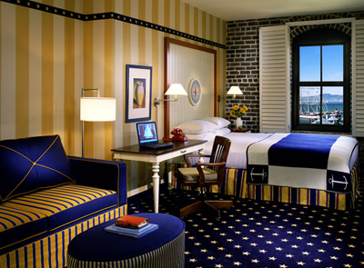
◇ 「Bolton Palace Hotel」から予約書が届く
（Your Booking N° BPH-19660798）
Booking number: N° BPH-19660798 Email: jnsasaki@tk2.so-net.ne.jp
Booked in the name of: Dr. Jin-Ichi Sasaki Country: Japan Type of room: 1 Classic Room: 1 Adult only £99.00 per night
Total number of guests:1 Room number: 209 Check-in: Sunday, 24 November 2013 (from 15:00)
Check-out: Saturday, 30 November 2013 (until 12:00)
Telephone: 196436403 One Classic Room - Breakfast excluded £594.00 VAT (20%) included £118.80 Options
Options Breakfast (1 person £10.00 x 6 nights) £60.00 Total Rate including VAT: £772.80 GCEDST 2013 15% Discount:£115.92 Total reservation payable:£656.88 PAYMENT METHOD: **Reservation payment through foreign credit cards are not acceptable for now because of credit card hackers. Visit any nearest Money Gram Office (www.moneygram.com) or Western Union (www.westernunion.com) for fund transfer to the Chief Accountant Mrs.Helen Jackson, 165A Borough High St London SE1 1HR, United Kingdom. CONFIRMATION: Forward the transfer details to enable us confirm your booking and prepare your reservation confirmation receipt at the earliest. CHILDREN POLICY: Accommodation is free for 1 child under 12 years sharing parents' room, a 50% discount is applied on breakfast. CANCELLATION POLICY: We are holding the reservation on a guaranteed basis. If you wish to cancel, you must cancel 48 Hours before the date of arrival. If canceled up to 2 days before date of arrival, no fee will be charged. If canceled later or in case of no-show, the first night will be charged.
We look forward to welcoming you to Bolton Palace Hotel and will do our utmost to ensure you have an enjoyable stay with us. Please do not hesitate to contact me if I can be of further assistance. Yours Sincerely, Ms. Rebecca Leuan Receptionist Department +447053828357
Bolton Palace Hotel Address: 165A Borough High Street London, SE1 1HR United Kingdom Phone: +447053828357 Website: www.boltonpalacehotel.co.uk
（一人で泊まるのにこんな立派な
部屋は要らない。）
6日間の宿泊料
送金方法
送金はMoney GramかWestern Unionでやってくれ。
上記の方法は個人対個人の送金方法で相手方の
受取人はHelen Jacksonである。
Credit Cardはハッカーがあるので受け付けていない
と書いてある。

Slide 10
◇ 「予約金の支払い方法」についてホテルマネジャーと連絡取ってくれ
（振込の口座を書いておけばいいのに其れがない、何で？）
GCEDST Grant Committee <accessgrant@gcedst2013.org.uk>
➐ 2013年10月18日 16:22
Dear Dr. Jin-Ichi Sasaki, Ex-Professor, Hirosaki University, Morioka, Iwate, JAPAN. Participation Code: GCEDST-208764
Contact the hotel management they will advice you on how to make your room reservation payment.
We look forward to seeing your delegation in London! Best Regards, GCEDST 2013 Access Grant Committee

Slide 11
◇ホテル予約金の送金は“Money Gram Agent”でとホテルからの指示
Bolton Palace Hotel <reservations@boltonpalacehotel.co.uk>
➑ 2013年10月19日 20:12
✓ Dear Dr .Jin-Ichi Sasaki, Our hotel administrative only receive payment that exceed £3,000.00 through bank account. Just log on http://moneylocations.com/moneygram/japan/iwate to read about the Money Gram Agent location in your Country which is the fastest means of sending funds to any Country in the world. Visit any of the Agent in this link above to make your payment, once you get to the Agent's office just collect the application form, write your name as the Sender's Name. Mrs. Helen Jackson is the Recipient's Name and Address is 165A Borough High St London SE1 1HR, United Kingdom. After filling the form you hand it over to the Agent with the amount you want to send, the Agent will send it in a minute and give you the transfer slip which you will send to us via email for immediate confirmation of your payment. Agent's Locations and Phone Numbers CALIMANESTI CACIULATA BCR IWATE Address: CALEA LUI TRAIAN 790-792 CALIMANESTI Phone: 547237 40250751165 .............................................. SC OPTIM EXCHANGE S R L CALIMANESTI IWATE Address: CALEA LUI TRAIAN NR 692 CALIMANESTI Phone: 245600 400788966889 Working Days Monday: 09:00 - 17:30 Tuesday: 09:00 - 17:30 Wednesday: 09:00 - 17:30 Thursday: 09:00 - 17:30 Friday: 09:00 - 17:30 Saturday: Closed Sunday: Closed If you are unable to pay for your room reservation the management will book the room to other delegate. Please do not hesitate to contact me if I can be of further assistance. Yours Sincerely, Ms. Rebecca Leuan Receptionist Department +447053828357
（当ホテルは３０００ポンド以上を送る場合には事務で受け付けるがそれ以下の金額の場合はMoney Gram Agentで送るようにとのこと。こんなホテルは初めてである。）

Slide 12
◇ 問い合わせでAgentへ電話したがこれも繋がらずそれの問い合わせへの返事
(Money Gram Agent について銀行で調べもらったら、「この方法は「個人対個人の送金方法」で出稼ぎに行った家族が残った家族に送金するときに使用されている。その辺の店で簡単に送金できる方法」とのことであった。
ホテルに送金するのに個人宛に送金する？ 下記の番号に電話したが繋がらず。）
➒ 2013年10月19日 20:12
Dear Dr. Jin-Ichi Sasaki, On Monday you should drive down to the Agent‘s location stated below to make the transfer in their office because if you want to send it personally through online it will take much longer than expected. Agent’s Locations and Phone Numbers CALIMANESTI CACIULATA BCR IWATE Address: CALEA LUI TRAIAN 790-792 CALIMANESTI Phone: 547237 40250751165 SC OPTIM EXCHANGE S R L CALIMANESTI IWATE Address: CALEA LUI TRAIAN NR 692 CALIMANESTI Phone: 245600 400788966889 Please do not hesitate to contact me if I can be of further assistance. Yours Sincerely, Ms. Rebecca Leuan Receptionist Department +447053828357
コンビニに行き、書類を書きしかるべき所に送り、カード
まで作ってもらった。ロンドン学会だけが頭にあった。

Slide 13
◇ 「学会は本当にあるのか（？）、ホテルを探したが見当たらない」
その説明をMikeに求め、その返事である
（会場にあたる当ホテルは今年新築し登録してある。ヒースローに着いたらホテルの車が迎えに行く）
⓬ 2013年11月4日 15:46
Dear Dr. Jin-Ichi Sasaki, Hirosaki University of Health Science, Japan.
Our conference will hold surely. Bolton Palace Hotel is a new hotel which was built middle of this year and registered with the British Government. Contact them via email they will respond to you. The hotel cars will be at the Heathrow International Air, Port join any of the cars to the hotel upon your arrival.
We look forward to meeting your delegation in London!
Congratulations!!
Regards,
Dr. Mike Lawrence, Conference Chairman 241b, Hoe Street, Walthamstow, London, E17 9PP, United Kingdom. Ph: +44 7053828354 Fax: +44 8435241465 Email: conference@gcedst2013.org.uk
Important Dates Deadline For Abstract Submission: 26th September, 2013 Final Paper Submissions: 29th October, 2013 GCEDST 2013 Conference Dates: 25-29 November, 2013
ホテルのないところに車で連れていかれ下ろされる。
望外の料金。荷物を持ってさてどうしたものか？
考えてだけでも恐ろしいことだ。
それより飛行場に迎えの車が来るはずがない。

Slide 14
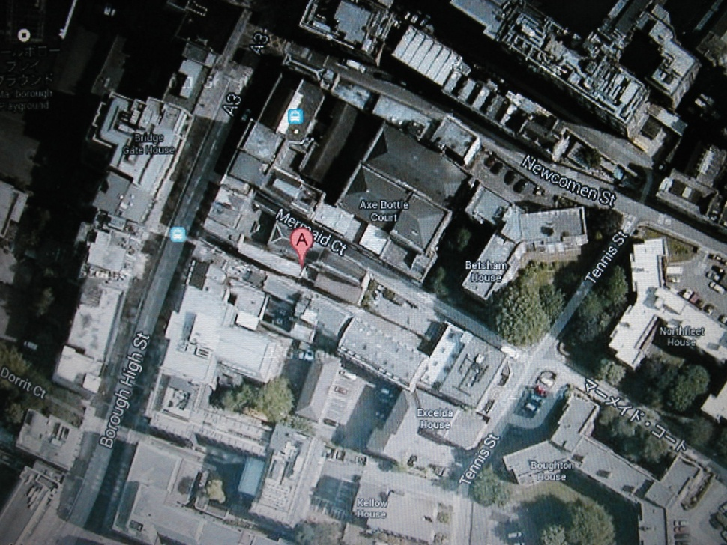
◇ロンドンの 「Bolton Palace Hotel」 の検索
（Googleで探したホテルの位置は右下の小路であった
Bolton Palace Hotel（学会からの情報） Address: 165A Borough High Street London, SE1 1HR United Kingdom Phone: +447053828357 Website: www.boltonpalacehotel.co.uk

Slide 15
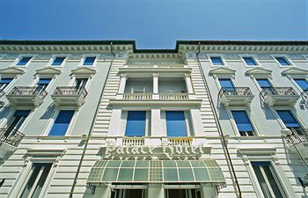
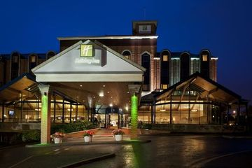
◇ロンドンには「Bolton Palace Hotel」はなく、在ったのは 「Bolton Hotel」と「Palace Hotel」であった
Palace Hotel
Bolton Hotel

Slide 16
「Scam Warners」
◇ 『この国際学会は詐欺学会である』 の指摘ネットが見つかる
（今回の学会）

Slide 17
◇告発文をMikeへ送り返事を待つ。ここまでくれば
私とMike間のゲームである
On Tue, Nov 5, 2013 at 1:41 AM, Sasaki Jinichi <jnsasaki@tk2.so-net.ne.jp> wrote:
Dr. Mike Lawrence
This is critical important information on your conference. I want to hear your views on this matter, please. You can get more details from the site www.scamwarners.com â€¢ View topic - GCEDST 2013
Jin-ichi Sasaki
The 2nd Global Conference on Environmental Dynamics, Science and Technology (GCEDST 2013). This Conference Scam is the (NON-EXISTENT) Global Conference on Environmental Dynamics, Science and Technology (GCEDST 2013) being presented by the NON-EXISTENT Environmental Dynamics Group at the (NON-EXISTENT) Bolton Palace Hotel. This scam promises free conference fees and reimbursed airline ticket fees in exchange for paying for a hotel room at a hotel THAT DOES NOT EXIST. Victims pay money and NEVER RECEIVE THE CONFERENCE FEES OR ARLINE TICKET REIMBURSEMENT!!! This fake conference is "scheduled" to be held 25 - 29 November 2013 at the NON-EXISTENT Bolton Palace Hotel 165A Borough High Steet London SE1 1HR, United Kingdom. This scam's fake website ( http://gcedst2013.org.uk/index.htm ) and the fake hotel's website ( http://boltonpalacehotel.co.uk/index-2.html ) are in the process of being suspended. The fake conference claims the following contact information: Dr. Mike Lawrence Conference Chair 241b, Hoe Street, Walthamstow, London, E17 9PP, United Kingdom
Ph:+447053828354 Fax:+448435241465 Email: conference@gcedst2013.org.uk
添付でMikeに送った告発文（下）

Slide 18
◇ R. Mikeからの返事は・・・
（学会発表が不採用になったウクライナ人が腹いせのために仕掛けたものである）
Dear Dr. Jin-Ichi Sasaki, Hirosaki University of Health Science, Japan.
Someone from Ukraine wanted to tarnish the image of our organization because his paper was not accepted. Everything about our conference is 100% legal.
We look forward to meeting your delegation in London!
Congratulations!!
Regards,
Dr. Mike Lawrence,
Conference Chairman 241b, Hoe Street, Walthamstow, London, E17 9PP, United Kingdom. Ph: +44Â 7053828354 Fax: +44Â 8435241465 Email:Â conference@gcedst2013.org.uk
Important Dates Deadline For Abstract Submission: 26th September, 2013 Final Paper Submissions: 29th October, 2013 GCEDST 2013 Conference Dates: 25-29 November, 2013

Slide 19
◇さらにMikeへ詰めよる
（学会へは行かないことに決めたので厳しく詰め寄った。私の発表日時、部門、座長の名
前を急いで知らせてくれ。学会への準備時間がもうないので）
GCEDST 2013 Experts (conference@gcedst2013.org.uk)
⓭2013年11月7日 7:38
Dr. Mike Lawrence,
What's going on the detailed schedule of conference such as the date of presentation, time limitation, section, name of chairperson et al.
Prompt indication will be necessary for my preparations. Time left is very short.
Thanks, again
Jin-ichi Sasaki
（発表日時などの通知を要求したが、それには解答なし。きた返事は前のメールの添付と同じもの
であった）

Slide 20
◇ロンドン国際学会長Mikeへ最後通牒！
1ヶ月間、君とゲームを楽しんだ。我々のゲームも終わりに近づいた。将来どこかでまた
会うこともあるだろう。その時まで バイ！
Final Mail To Mike
Your mail did not answer my questions inquired in my last writings. I needed definite information on my podium section, time, date, and chairperson's name.
Mike, no more time to continue correspondence with you. I should say “Thank you” again. I have spent really enjoyable time to play the game with you for a month. Our game finally comes to the end. See you somewhere
in future again. Bye until then.
ネットで流していた国際学界の開催案内は数日後には消えた。私は航空券キャンセルのため3万ほど支払った。
こうして夢のような話は終わった。

